Slide 1

Stock Stance Dashboard with Fine-Tuned LLM
DSC 670 – Term Project (Milestone 4)
11/23/2025
Bellevue University
Zicheng (Chance) Xu
DSC670-T301 Advanced Uses of Generative AI (2261-1)
Professor: Frank Neugebauer

Slide 2




Project Overview
Goal
Inputs
Output
Final Delivery
Build an end-to-end pipeline that scores my stock watchlist using
technical indicators + a fine-tuned OpenAI model.
Chance_Watchlist.csv (129 tickers + names)
Market data from Yahoo Finance
CSV with engineered metrics, rule-based local_score, LLM stance & score, and final_decision
Interactive Streamlit dashboard for exploration
Bellevue University
DSC 670 – Term Project (Milestone 4)

Slide 3
Data Sources & Engineered Features
Watchlist
Market Data (Yahoo Finance)
Key Features (per ticker)
💡
📊
📣
Source: Personal CSV of tickers and company names
Normalized to Yahoo Finance symbols (e.g., BRK.B → BRK-B)
~420 days of daily OHLCV per ticker
Downloaded in batches via yfinance
Price metrics: close, change_1d, 52-week hi_52w, lo_52w
Technical indicators:
RSI, MACD (line, signal, hist)
Bollinger Bands: bb_mid, bb_upper, bb_lower, bb_pctb, bb_bandwidth
Support / resistance using local extrema
TD Sequential signals + counts + perfected flags
Bellevue University
DSC 670 – Term Project (Milestone 4)

Slide 4
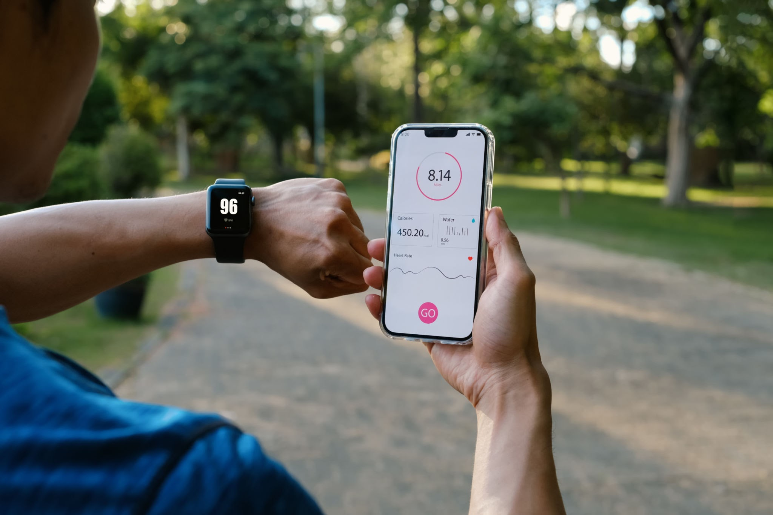
Local Rule-Based Scoring (Technical View)
For each ticker, we derive tags from metrics (e.g.):
RSI_oversold, MACD_bullish, near_lower_band
TD_recent_buy9, TD_buy_perfected, on_support, etc.
A simple heuristic converts tags → integer local_score:
Bullish signals add points (e.g., RSI oversold, MACD bullish, support)
Bearish signals subtract points (e.g., RSI overbought, MACD bearish, resistance)
This yields a technical-only stance:
in roughly [-3, 3]
Bellevue University
DSC 670 – Term Project (Milestone 4)

Slide 5

Fine-Tuned LLM Stance Head
Fine-tuned model:
Model: ft:gpt-4o-mini-2024-07-18:personal:stance-head-v1:…
Trained on structured examples:
features → (stance, score, summary)
Configured to m3_artifacts/inference_config.json:
fine_tuned_model, system_prompt_path
feature_cols (numeric + tag features)
symbol_col, date_col
For each row, the model returns:
llm_stance ∈ {BULLISH, NEUTRAL, BEARISH}
llm_score ∈ [-2, 2]
llm_summary – 1–2 sentence explanation
Bellevue University
DSC 670 – Term Project (Milestone 4)

Slide 6
Combine technical local_score and LLM score into final_score:
Map final_score to final_decision buckets:
Output CSV:
Blending Local Score + LLM Score
Normalize local_score from [-3, 3] → [-1, 1]
Normalize llm_score from [-2, 2] → [-1, 1]
Blend: final_score = 0.4 * local_norm + 0.6 * llm_norm
≥ 0.75 → Strong Buy
0.25 – 0.75 → Buy
-0.25 – 0.25 → Hold
-0.75 – -0.25 → Sell
≤ -0.75 → Strong Sell
One row per ticker with Name, symbol, metrics, tags,
local_score, llm_*, final_score, final_decision
Bellevue University
DSC 670 – Term Project (Milestone 4)

Slide 7

Python Pipeline: From Watchlist to Scored CSV
build_watchlist_with_llm.py:
Loads Chance_Watchlist.csv, normalizes symbols
Downloads price history via yfinance
Computes indicators + tags + local_score
Calls fine-tuned model to add llm_stance, llm_score, llm_summary
Blends scores → final_score, final_decision
Saves watchlist_with_llm_YYYYMMDD.csv
streamlit_app.py:
Loads the latest watchlist_with_llm_*.csv
Provides interactive dashboard (filters, tables, charts)
Includes a “Refresh data” button wired to run_pipeline(with_llm=True)
Bellevue University
DSC 670 – Term Project (Milestone 4)

Slide 8
Excel-like interaction:
Streamlit Dashboard – Main View
Loads latest model output CSV automatically
Click headers to sort by any metric
Sidebar filters to narrow by name, symbol, stance, decision, and score ranges
Useful for scanning opportunities and threats across the entire watchlist
Bellevue University
DSC 670 – Term Project (Milestone 4)

Slide 9
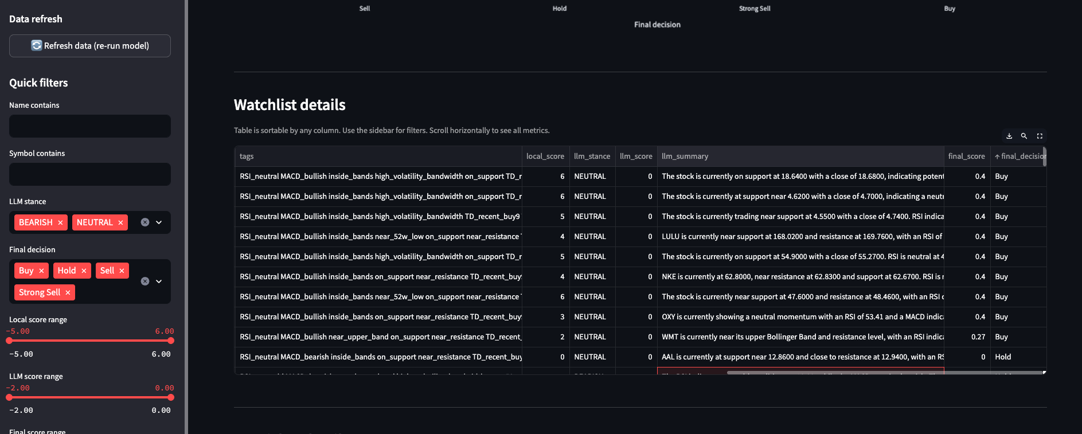
Streamlit Dashboard – Main View
Bellevue University
DSC 670 – Term Project (Milestone 4)

Slide 10
Summary KPIs give at-a-glance view of:
Decision distribution bar chart:
Streamlit Dashboard – Summary & Filters
Number of active tickers (after filters)
Most common decision bucket
Average final score for the filtered subset
Visual check of how many tickers land in each bucket
Helps quickly see if the watchlist skews bullish/bearish
Bellevue University
DSC 670 – Term Project (Milestone 4)

Slide 11
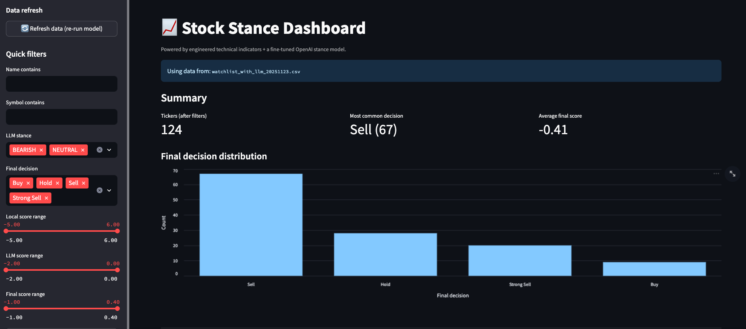
Streamlit Dashboard – Summary & Filters
Bellevue University
DSC 670 – Term Project (Milestone 4)

Slide 12
Drill-down view for a single ticker:
LLM Summary provides:
Streamlit Dashboard – Per-Ticker Detail
Full metrics and scoring for the selected symbol
tags show the technical context behind the local_score
Short natural language explanation of the setup
Justification for stance and score (“why is this Strong Buy / Sell?”)
Bellevue University
DSC 670 – Term Project (Milestone 4)

Slide 13
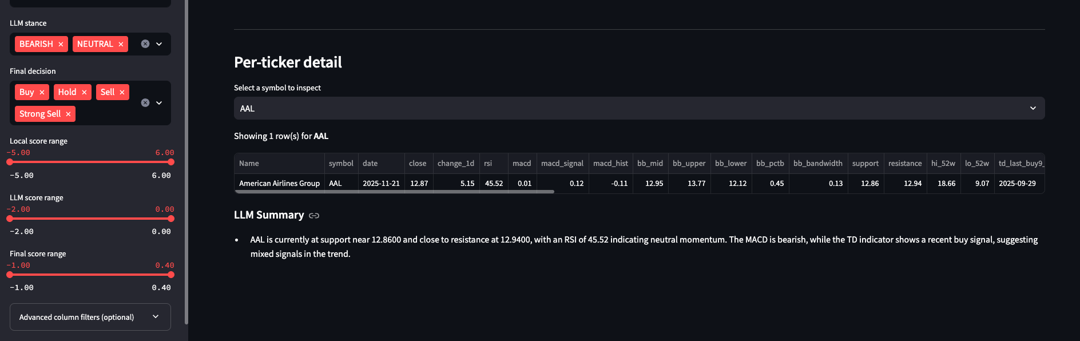
Streamlit Dashboard – Per-Ticker Detail
Bellevue University
DSC 670 – Term Project (Milestone 4)

Slide 14
Limitations & Future Work
Current model is based on daily data and technical indicators only:
No direct use of fundamentals or news sentiment yet
Fine-tuning dataset size is limited to this course project
Future improvements:
Add fundamentals (P/E, revenue growth, etc.) as extra features
Integrate recent news / sentiment in the stance head
Backtest decisions vs. historical performance
Schedule automatic daily runs and publish dashboard online
Bellevue University
DSC 670 – Term Project (Milestone 4)

